Slide 1
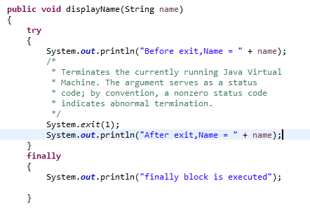
finally
Does system.exit() in try block executes code in finally block?
The answer is no. It will not execute finally block. The program will be terminated after System.exit() statement.

